Slide 1
Web Services
Software components that can be published, located, and run over the Internet using Extensible Markup Language (XML)

Slide 2
Introduction to Web Services
Web Services can convert your applications into Web-applications.
Web Services are published, found, and used through the Web.
What You Should Already Know
Before you continue, you should have a basic understanding of the following:
HTML
XML

Slide 3
What are Web Services?
Web services are application components
Web services communicate using open protocols
Web services are self-contained and self-describing
Web services can be discovered using UDDI
Web services can be used by other applications
XML is the basis for Web services

Slide 4
Eg – Weather Forecast to start with Web Services
The clients (programs that want to access the weather information) would then contact the Web Service (in the server), and send a service request asking for the weather information.
The server would return the forecast through a service response. Of course, this is a very sketchy example of how a Web Service works. We'll see all the details in a moment.

Slide 5
Web Services ! Have Advantages.,
Some of you might be thinking: "Hey! Wait a moment! I can do that with RMI, CORBA, EJBs, and countless other technologies!"
So, what makes Web Services special? Well, Web Services have certain advantages over other technologies:
Web Services are platform-independent and language- independent, since they use standard XML languages. This means that my client program can be programmed in C++ and running under Windows, while the Web Service is programmed in Java and running under Linux.

Slide 6
Ctd..
Most Web Services use HTTP for transmitting messages (such as the service request and response).
This is a major advantage if you want to build an Internet-scale application, since most of the Internet's proxies and firewalls won't mess with HTTP traffic (unlike CORBA, which usually has trouble with firewalls).

Slide 7
How Does it Work?
The basic Web services platform is XML + HTTP.
XML provides a language which can be used between different platforms and programming languages and still express complex messages and functions.
The HTTP protocol is the most used Internet protocol.
Web services platform elements:
SOAP (Simple Object Access Protocol)
UDDI (Universal Description, Discovery and Integration)
WSDL (Web Services Description Language)

Slide 8
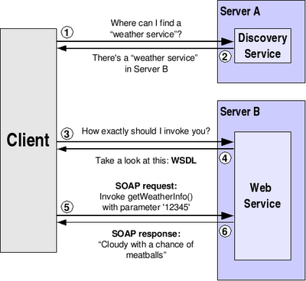
Generic Scenario

Slide 9
How it works !
As we said before, a client may have no knowledge of what Web Service it is going to invoke. So, our first step will be to discover a Web Service that meets our requirements. We'll do this by contacting a discovery service (which is itself a Web service).
The discovery service will reply, telling us what servers can provide us the service we require.
We now know the location of a Web Service, but we have no idea of how to actually invoke it. The method I have to invoke might be called “ in different ways". We have to ask the Web Service to describe itself (i.e. tell us how exactly we should invoke it)

Slide 10
The Web Service replies in a language called WSDL.
We finally know where the Web Service is located and how to invoke it. The invocation itself is done in a language called SOAP.
The Web Service will kindly reply with a SOAP response which includes the forecast we asked for, or maybe an error message if our SOAP request was incorrect.

Slide 11
Web Services have Two Types of Uses
Reusable application-components.
There are things applications need very often. So why make these over and over again?
Web services can offer application-components like: currency conversion, weather reports, or even language translation as services.
Connect existing software.
Web services can help to solve the interoperability problem by giving different applications a way to link their data.
With Web services you can exchange data between different applications and different platforms

Slide 12
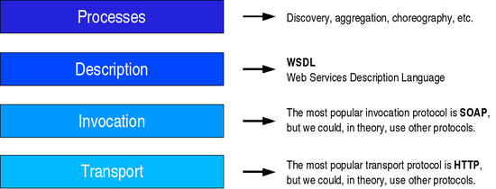
Web Services Architecture

Slide 13
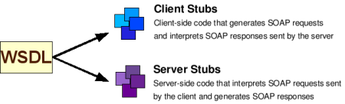
How does this work in practice?
For example, the discovery registry might have replied with the following URI:
http://webservices.mysite.com/weather/us/WeatherService

Slide 14
What is SOAP?
SOAP is an XML-based protocol to let applications exchange information over HTTP.
SOAP is a protocol for accessing a Web Service.
SOAP stands for Simple Object Access Protocol
SOAP is a communication protocol
SOAP is a format for sending messages
SOAP is designed to communicate via Internet
SOAP is platform independent
SOAP is language independent
SOAP is based on XML
SOAP is simple and extensible
SOAP allows you to get around firewalls
SOAP is a W3C standard

Slide 15
A Web Service Example
<%@ WebService Language="VBScript" Class="TempConvert" %> Imports System Imports System.Web.Services Public Class TempConvert :Inherits WebService <WebMethod()> Public Function FahrenheitToCelsius (ByVal Fahrenheit As String) As String dim fahr fahr=trim(replace(Fahrenheit,",",".")) if fahr="" or IsNumeric(fahr)=false then return "Error" return ((((fahr) - 32) / 9) * 5) end function <WebMethod()> Public Function CelsiusToFahrenheit (ByVal Celsius As String) As String dim cel cel=trim(replace(Celsius,",",".")) if cel="" or IsNumeric(cel)=false then return "Error" return ((((cel) * 9) / 5) + 32) end function end class

Slide 16
Using the Web Service Example
In the previous page we created a Web service.
The FahrenheitToCelsius() function can be tested here: FahrenheitToCelsius
The CelsiusToFahrenheit() function can be tested here: CelsiusToFahrenheit
These functions will send an XML response like this:
<?xml version="1.0" encoding="utf-8" ?> <string xmlns="http://tempuri.org/">38</string>

Slide 17
Put the Web Service on Your Web Site
Using a form and the HTTP POST method, you can put the web service on your site, like this:
Fahrenheit to Celsius: Celsius to Fahrenheit:

Slide 18
Now You Know Web Services, What's Next?
The next step is to learn about WSDL and SOAP.
SOAP
SOAP is a simple XML-based protocol that allows applications to exchange information over HTTP.
Or more simply: SOAP is a protocol for accessing a web service.
WSDL
WSDL is an XML-based language for describing Web services and how to access them.
WSDL describes a web service, along with the message format and protocol details for the web service.

Slide 19
Executive Summary
Web services
Software components that can be run over the Internet using XML
Reasons to use Web services
Applications can be built that are platform-independent, distributed, and secure
Technologies
XML, UDDI, WSDL, and SOAP
Web Services Architecture (WSA)
Set of protocols that solve the problems that every distributed application faces

